Slide 1
Visit Pacifica Bay
Presented by
Pacifica Bay Tourism and Travel Department

Slide 2
Weekend Getaways!

Slide 3
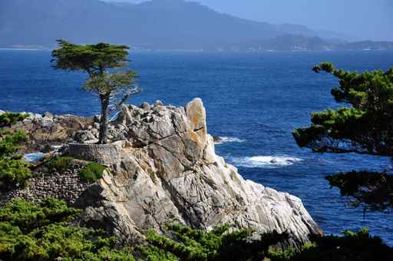
Why Visit?
Miles of beaches with excellent surf
Variety of hotels in all price points
Five-star cuisine and outstanding local ownership boutique restaurants
Large artisan community
Activities for all age groups

Slide 4
Visitor Patterns by Season

Slide 5
Beautiful beaches and parks, amazing wildlife, and stunning vistas are a few of the things you can expect to see when you visit Pacifica Bay!

Slide 6
We look forward to welcoming you to our city!

